Slide 1


© Niels Swimberghe
https://swimburger.net - @RealSwimburger

Slide 2

About me
Niels Swimberghe aka Swimburger
.NET Web Developer
Blog at swimbuger.net
Twitter: @RealSwimburger

Slide 3

What is GitHub Pages?
Static site hosting service (HTML, CSS, JavaScript, etc.)
Support custom domains
Always public even when repository is not
Built-in support for Jekyll static site generator, but not required
Free, but no SLA
Usage limits - Prohibited uses

Slide 4

Alternatives?
Azure Static Web Apps (Blazor WASM Walkthrough)
Firebase Hosting (Blazor WASM Walkthrough)
Netlify
Vercel
Cloudflare in front of GitHub Pages
Many more

Slide 5
Types of GitHub Pages
User site => [username].github.io
Organization site => [organization].github.io
Project site => [username].github.io/[repository_name] => [organization].github.io/[repository_name]

Slide 6
How to create GitHub Pages site without Jekyll
Create a GitHub repository
Commit static files to repository
Configure branch as GitHub Pages source in repository settings - or - create a gh-pages branch
Wait for GitHub to deploy the site

Slide 7
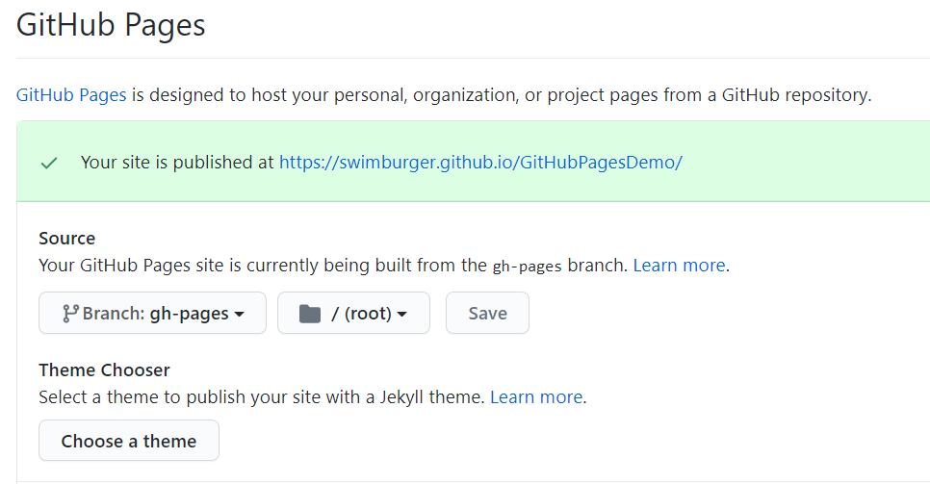
Basic GitHub Pages Demo
Notes:
mkdir GitHubPagesDemo
cd GitHubPagesDemo
code .
git init
git status
git add --all
git commit -m "Initial Commit"
git remote add origin https://github.com/Swimburger/GitHubPagesDemo.git
git branch -M main
git push -u origin main
git branch gh-pages
git checkout gh-pages
git push --set-upstream origin gh-pages

Slide 8
How to manually deploy Blazor WASM to GitHub Pages
dotnet publish => output is all static files
Commit output to gh-pages branch
Fix whatever is broken

Slide 9

Manual Blazor WASM to GitHub Pages Demo
Notes:
git checkout main
dotnet new blazorwasm
dotnet new gitignore
git add --all
git status
git commit -m "Add Blazor WASM“
git push
dotnet publish -c Release -o release
tree release /F
mv release/* ../temp-release
git checkout gh-pages
rm -r bin
rm -r obj
mv ../temp-release/wwwroot/* . –Force
"* binary" >> .gitattributes
git add --all
git commit -m "Add publish blazor WASM“
git push

Slide 10
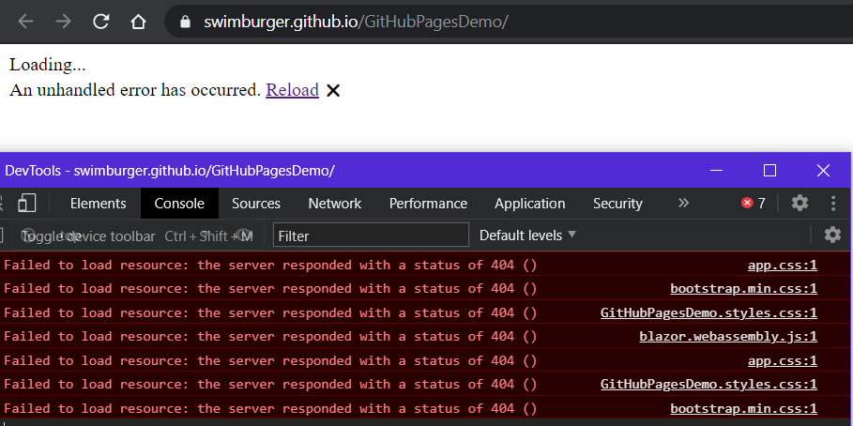
Notes:
Update <base href="/GitHubPagesDemo/" />
git add --all
git commit -m "Fix base tag in subfolder“
git push

Slide 11
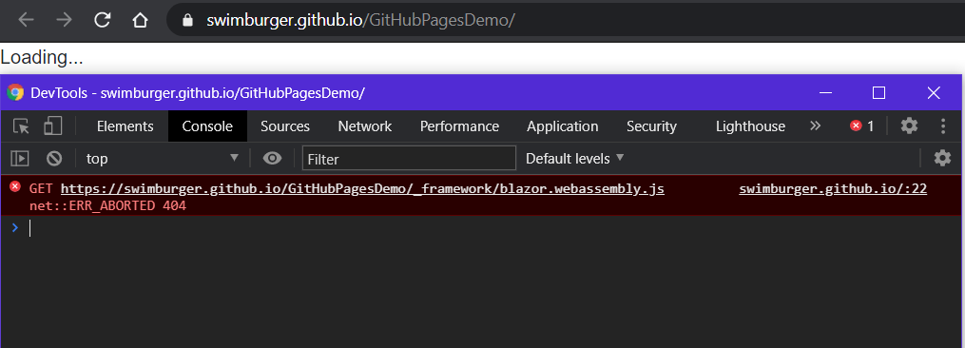

😡
😡
Notes:
git add --all
git commit -m "Add .nojekyll file“
git push

Slide 12

Notes:
Unlike Azure Static Web Apps and other static site hosting's, GitHub Pages does not support customizable routing
But they do have support for a custom 404 page which we can abuse
cp index.html 404.html git add --all
git commit -m "Add 404 copy of index.html“
git push

Slide 13
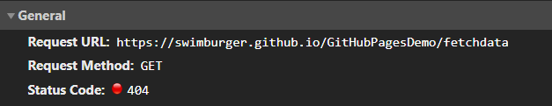
/fetchdata, /counter does return the Blazor application successfully
BUT the HTTP Status code is still 404 This is bad for SEO, but non-prerender Blazor WASM is already bad for SEO 🤷‍♂️
You could create copies of index.html at /fetchdata/index.html, /counter/index.html, etc.
Notes:
Unlike Azure Static Web Apps and other static site hosting's, GitHub Pages does not support customizable routing
But they do have support for a custom 404 page which we can abuse
cp index.html 404.html git add --all
git commit -m "Add 404 copy of index.html“
git push

Slide 14
What is GitHub Actions?
Hosted Workflow Automation
Runs on hosted images (Windows, Linux, Mac, custom)
Free and paid plans
Written in YAML
Use existing actions

Slide 15
Blazor WASM to GitHub Pages with GitHub Actions Demo
Notes:
Create GitHub Actions Workflow in the browser
name: Deploy to GitHub Pages
# Run workflow on every push to the master branch
on:
push:
branches: [ main ]
jobs:
deploy-to-github-pages:
# use ubuntu-latest image to run steps on
runs-on: ubuntu-latest
steps:
# uses GitHub's checkout action to checkout code form the master branch
- uses: actions/checkout@v2
# sets up .NET Core SDK 5.0.101
- name: Setup .NET Core SDK
uses: actions/setup-dotnet@v1
with:
dotnet-version: 5.0.101
# publishes Blazor project to the release-folder
- name: Publish .NET Core Project
run: dotnet publish -c Release -o release --nologo
# changes the base-tag in index.html from '/' to 'GitHubPagesDemo' to match GitHub Pages repository subdirectory
- name: Change base-tag in index.html from / to GitHubPagesDemo
run: sed -i 's/<base href="\/" \/>/<base href="\/GitHubPagesDemo\/" \/>/g' release/wwwroot/index.html
# copy index.html to 404.html to serve the same file when a file is not found
- name: copy index.html to 404.html
run: cp release/wwwroot/index.html release/wwwroot/404.html
# add .nojekyll file to tell GitHub pages to not treat this as a Jekyll project. (Allow files and folders starting with an underscore)
- name: Add .nojekyll file
run: touch release/wwwroot/.nojekyll
- name: Commit wwwroot to GitHub Pages
uses: JamesIves/github-pages-deploy-action@3.7.1
with:
GITHUB_TOKEN: ${{ secrets.GITHUB_TOKEN }}
BRANCH: gh-pages
FOLDER: release/wwwroot

Slide 16

SUCCESS!?

Slide 17


More .NET, Web, Azure, etc.
@RealSwimburger
https://swimburger.net

